Slide 1
MTA Exploratory Data Analysis Project
TIA ALZANAN

Slide 2
Overview
As many people in New York City use The Metropolitan Transportation subways as main transportation
In this project I analyzed MTA data to locate the busiest stations and units to help MTA determine commercials prices and help companies to choose the best station and units to have better ads viewers

Slide 3
Goal /Questions :
Determine the prices of advertisements in the stations according to the traffic.
suggesting the best stations and units for placing advertisements for companies.
What are the stations that have the most traffic?
What are the Control units that have the most traffic?
What are the best units for placing my ads?

Slide 4
الهيــــكــــــل التنظـــــيمي لفريق العمل
Project
Details

Slide 5
Data& Database
Sample size
3 months dataset from MTA website (http://web.mta.info)
Database
Created a cloud Postgres database by Google Cloud

Slide 6
Cleaning Data
Delete the space from columns
Filter the data to only daily entries and exits
Add Daily_entries coulmn by finding the difference from ENTRIES column
Add Daily_exits coulmn by finding the difference from EXITS
column
Add Daily_trafic coulmn by using Daily_exits + Daily_entries
Convert date to day_of_week and month

Slide 7
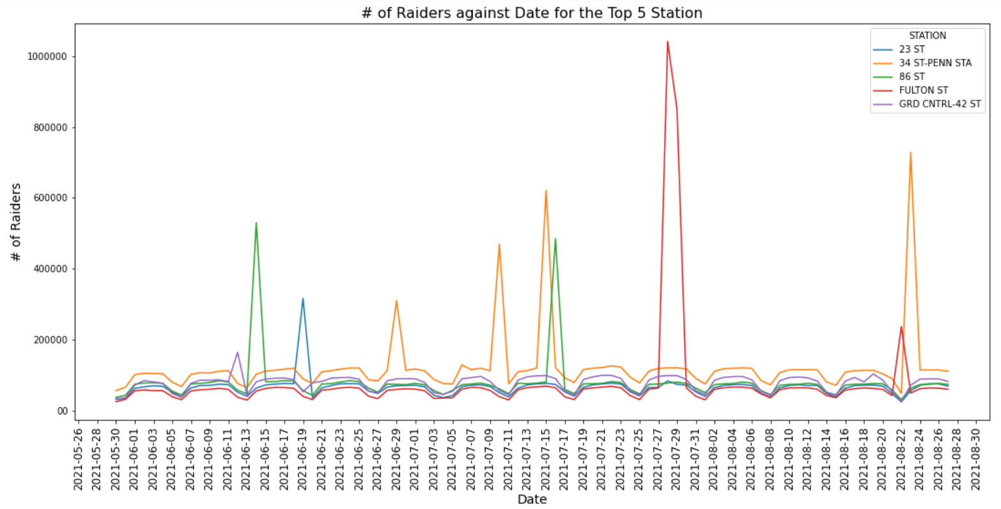
Num of Raiders VS Date for the Top 5 Station
From here we can see that 34 ST-PENN STA station was the busiest station but there are some interesting dates like the 2021-07-28 was the busiest day for the FULTON ST station it was the was has the most traffic between the 5 stations on a day.

Slide 8
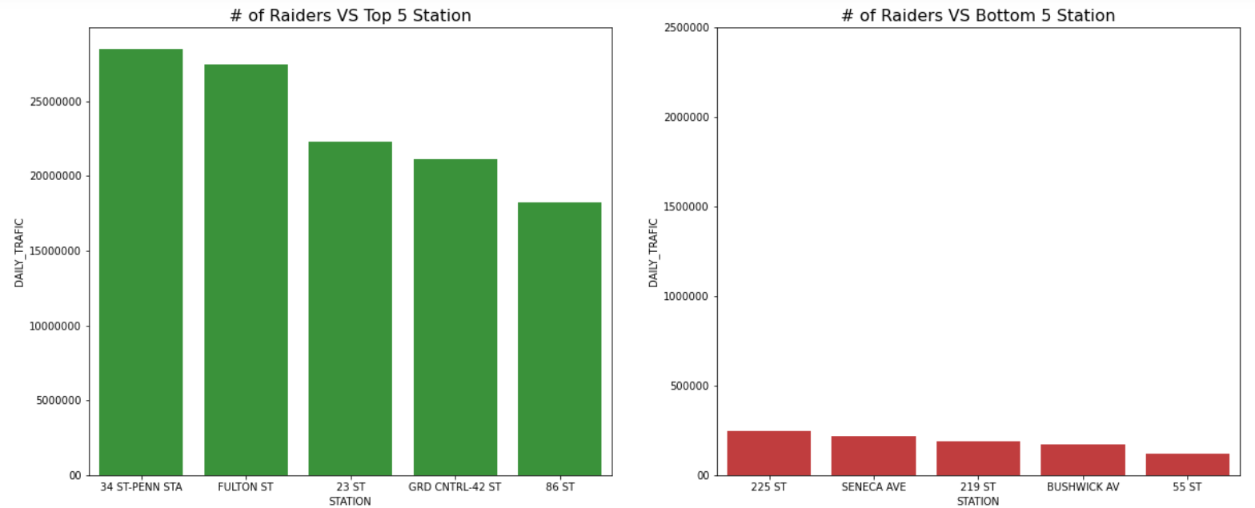
Comparison between the top 5 stations and the bottom 5 stations
From here we can notice that there are a huge deference on traffic between them. like the station 86 ST it has more traffic than the bottom 5 stations combined!.

Slide 9
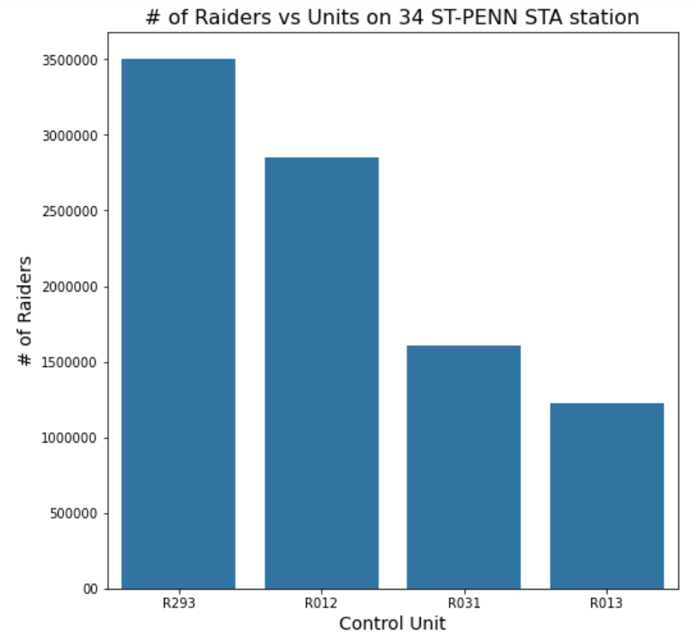
Comparison between the Units and number of raiders.
From this graph we notice that even on units there is a large deference on traffic for each unit for example the unit R293 has more than double raiders on the unit R035.

Slide 10
Conclusion
This is a sample of how we can use the MTA data to improve your ads at MTA station I used 3 months for this analysis, and I had some very interesting insights that may help MTA determine commercials prices and suggesting the best stations and units for placing adds for companies
Found busy days for stations
Comparison between the Top Stations and bottom stations. and found there is a very large deference.
Have better understand that where is the busiest Control Units.
Have better understand that where is the busiest Units.

Slide 11

The End
Thank you for your time

